Slide 1
Java
programming
Learning java if, else if, else statements
Grope: 7

Slide 2
Java_ decision Making
If Statement in Java
If_else Statement in Java
The if…else if…else Statement

Slide 3
Java Conditions and If Statements
Java supports the usual logical conditions from mathematics:
Less than: a < b
Less than or equal to: a <= b
Greater than: a > b
Greater than or equal to: a >= b
Equal to a == b
Not Equal to: a != b

Slide 4
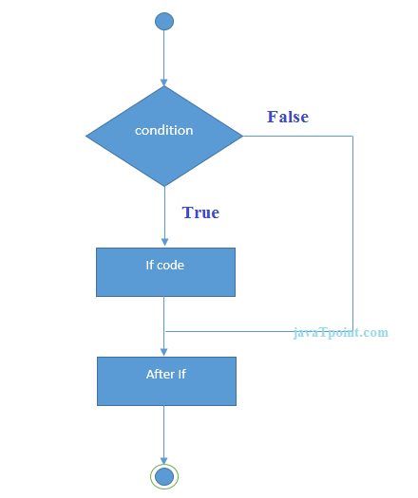
Java if Statement The Java if statement tests the condition. It executes the if block if condition is true.
Syntax:
if(condition){
//code to be executed
}

Slide 5
A. The if…Statement
Use the if statement to specify a block of Java code to be executed if a condition is true.
public class Main {
public static void main(String[] args) {
int x = 20;
int y = 18;
if (x > y) {
System.out.println("20 is greater than 18");
}
}
}
// Outputs “20 is greater than 18”

Slide 6
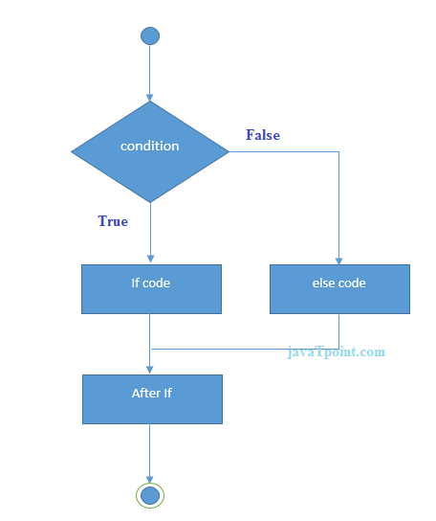
Java if-else Statement The Java if-else statement also tests the condition. It executes the if block if condition is true otherwise else block is executed.
Syntax:
if(condition){
//code if condition is true
}else{
//code if condition is false
}

Slide 7
B. The if…else statement
Use the else statement to specify a block of code to be executed if the condition is false.
public class Main {
public static void main(String[] args) {
int time = 20;
if (time < 18) {
System.out.println("Good day.");
} else {
System.out.println("Good evening.");
}
}
}
// Outputs “Good evening.”

Slide 8
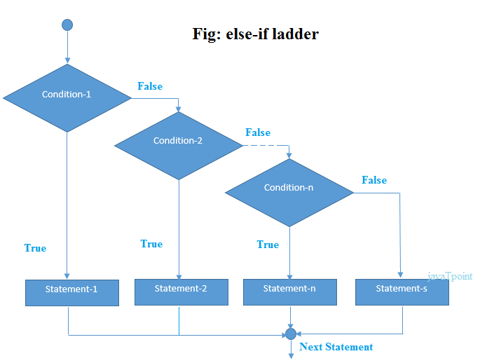
Java if-else-if ladder Statement The if-else-if ladder statement executes one condition from multiple statements.
Syntax:
if(condition1){
//code to be executed if condition1 is true
}else if(condition2){
//code to be executed if condition2 is true
}
else if(condition3){
//code to be executed if condition3 is true
}
...
else{
//code to be executed if all the conditions are false
}

Slide 9
C.The if…,else if…, else… statement
Use the else if statement to specify a new condition if the first condition is false.
public class Main {
public static void main(String[] args) {
int time = 22;
if (time < 10) {
System.out.println("Good morning.");
} else if (time < 20) {
System.out.println("Good day.");
} else {
System.out.println("Good evening.");
}
}
}
// Outputs “Good evening.”

Slide 10
Java Short Hand If...Else (Using Ternary Operator) It can be used to replace multiple lines of code with a single line, and is most often used to replace simple if else statements:
Syntax:
variable = (condition) ? expressionTrue : expressionFalse;
public class Main {
public static void main(String[] args) {
int time = 20;
String result;
result = (time < 18) ? "Good day." : "Good evening.";
System.out.println(result);
}
}
//Outputs”Good evening.”

Slide 11
Thanks you!

